Slide 1
HOST CASE 1
TOF for Valve-sparing Repair

Slide 2
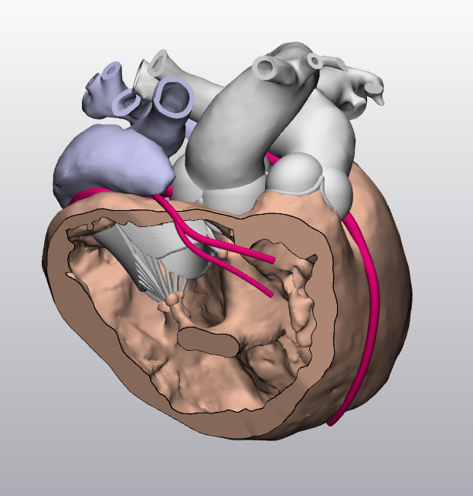
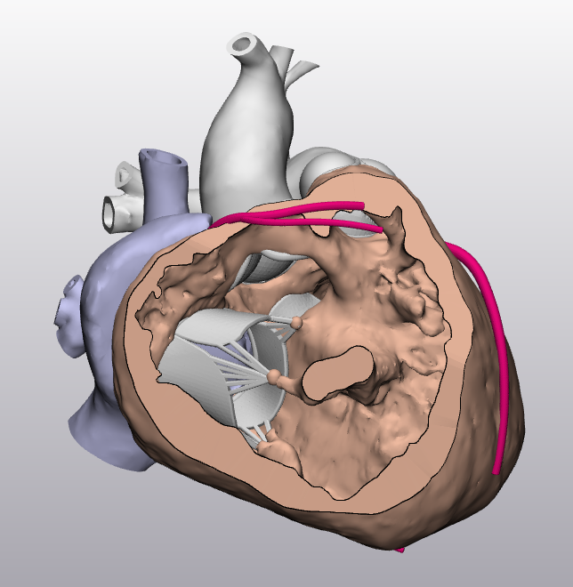

Slide 3
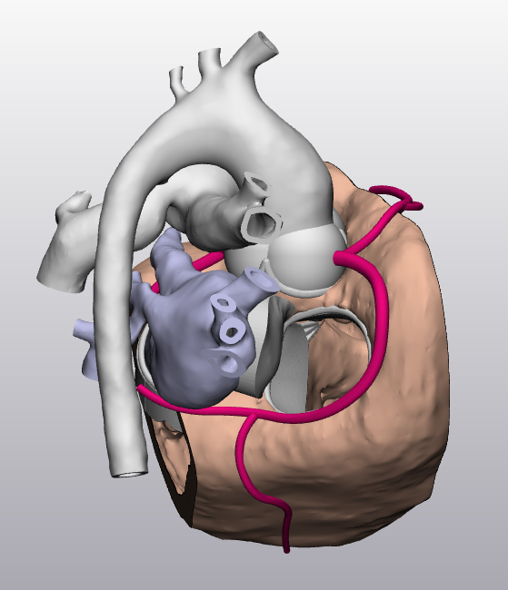

Slide 4
HOST CASE 2
TOF for Transannular Patch Repair

Slide 5
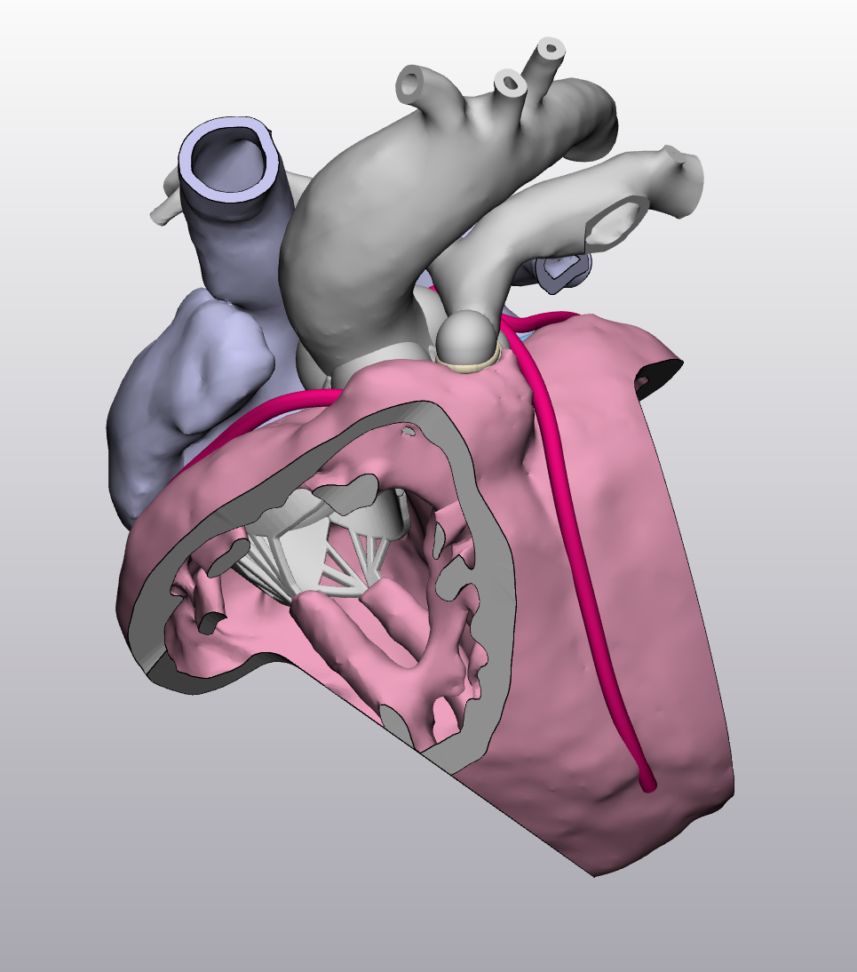
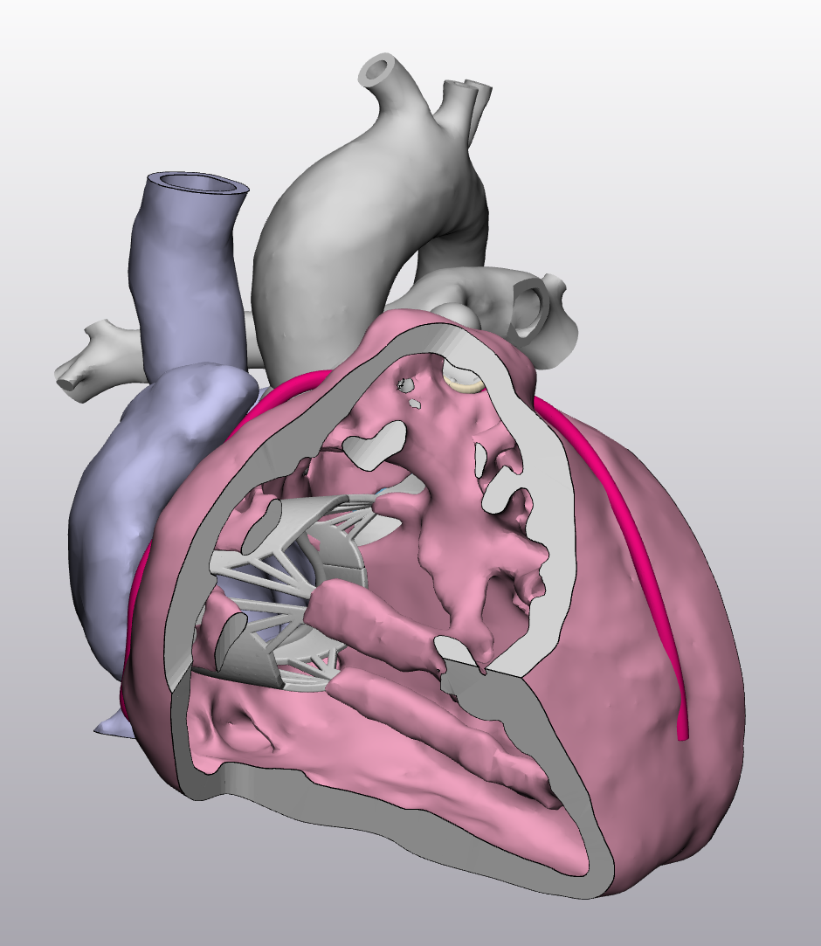

Slide 6
